Slide 1
COMPUTER GRAPHICS LAB MINI PROJECT DEMO

Slide 2
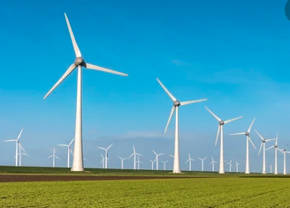
TOPIC: WIND MILL STIMULATION
Presented By
- B Anitha -1ME18CS010
-Pushpa B M – 1me18cs048

Slide 3
Why only wind mill?
When we have mini project on open gl in c language we thought to maximum user defined functions need to implement and intersting so , we thought some continous moving stimulation is better , later we choosed wind mill as it meets most of our requirements.

Slide 4
About mini project
In this project we designed the simulation of windmill using OpenGL.
We used transformation functions like translate and rotate functions to design blades of the windmill.
We used many OpenGL inbuilt function to design the structure of windmill.

Slide 5
About mini project
This project consist of many user defined function such as increasing windmill fan speed, decreasing windmill fan speed, side views, front and back views, custom angle of rotation of entire windmill structure.
We can rotate the entire windmill with respect to its axis using the arrow keys of keyboard. It can be rotate through 360⁰.

Slide 6
REQUIREMENTS
Hardware requirements
Processor : Pentium Processor
Processor Speed : 333 MHz
RAM : 32 MB or Higher
Graphics Card : 512MB
Monitor : Color
Keyboard : Low Profile, Dispatchable Type
I/O Parts : Mouse, Monitor

Slide 7
Requirements
Software requirements
Operating System : Windows 98/XP or Higher
Programming Language : C,C++
Microsoft Visual Studio 2005 or higher: This Software package containing visual basics in c++ language is required.
Toolkit : GLUT Toolkit, VC++

Slide 8


